Slide 1


Using CNN to Classify Pokemon
Kris Seo
Mentor: Preetjot Singh

Slide 2
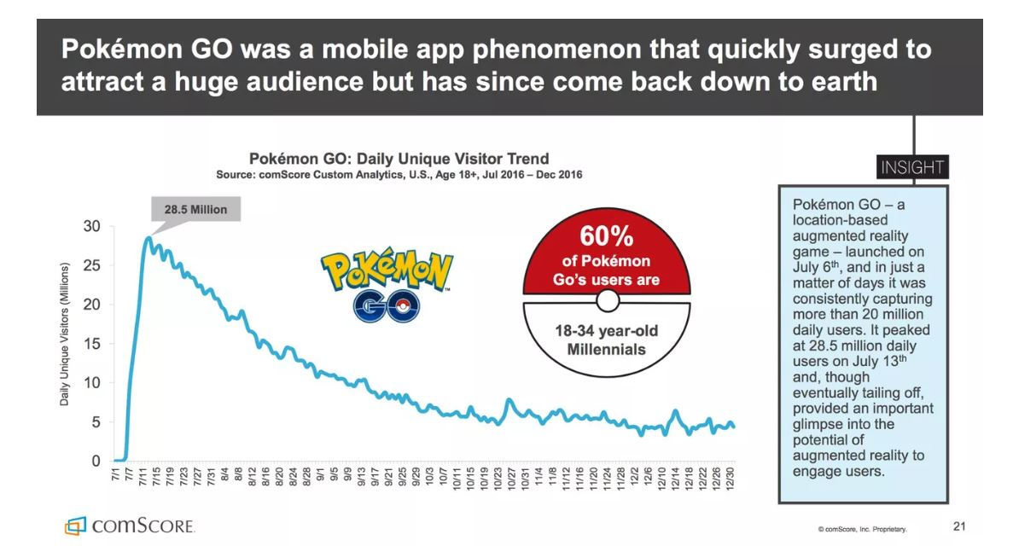
Motivation
As a kid growing up in 90s, I wondered about catching Pokémon, battling in gyms and using that cool Pokédex to get the info all I need.
Pokemon Go quickly became the most downloaded game of all time, reaching 15 million users in a week.
As a part of active and eager users for Pokemon Go, I want to develop Pokedex by using Convolution Neural Network.

Slide 3



Who can be beneficial from Pokedex?
These toy industries can be beneficial by building image classification toys.
Kids are always curious about what characters they are seeing and can have better attention to stories with image classifiers.
Kids having image classifiers will have much more fun by describing fictional characters and can increase their memory of stories.

Slide 4
Data Overview
Obtain Pokémon Image datasets from Kaggle, one collected by human and the other collected by Bing API.
After combining two datasets, I need to thoroughly and manually delete duplicated and improper image files to prevent noise.
There are total of 42,022 image files for 151 Pokémon, which is relatively a small dataset for building CNN.
A rule of thumb for image classification is 1,000 images per class.

Slide 5
Approach
Summarize each pokémon image with Histograms of Oriented Gradients.
HOG is a feature descriptor by calculating gradient magnitude and direction over each cell block in an image.
With feature descriptors, Support Vector Classifier is applied to classify Pokémon.
CNN is explicitly used for classifying images and inspired by human visual cortex.
Constructed an architecture of Convolutional Neural Network very similar to human.
Trained the Neural Network via Amazon Web Service EC2.
Compare these two classifiers with a test data.

Slide 6
Data Wrangling
Convert all image files to png file, which is a lossless compression type.
All files are converted to ndarray object with 64 x 64 pixel values between 0 and 255 with 3 RGB values.
Apply Normalization by dividing pixel values by 255 to train my model faster.
Therefore, the shape of ndarray for each image is (64,64,3)

Slide 7
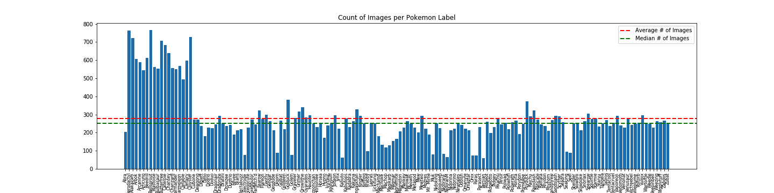
EDA
Some of Pokémon contain more than 500 images; however, the image data appears to be unfairly balanced overall.

Slide 8
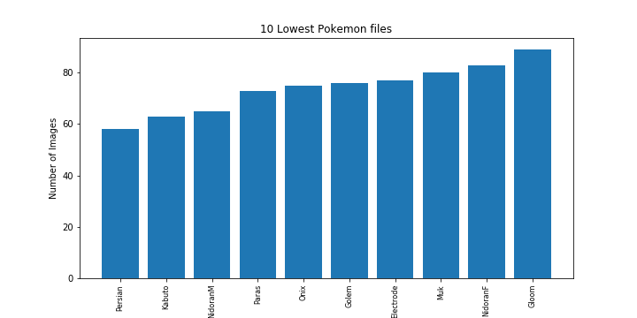
10 Lowest Pokémon Images
Since these Pokémon contain less than 100 images, Convolution Neural Network and other models will not work well these Pokémon.

Slide 9
Histograms of Oriented Gradients
Basic idea of H.O.G is that local shape information often well described by distribution of intensity or with edge directions.
Gradient magnitude is calculated by calculating pixel intensity between horizontal gradient and vertical gradient of a given image.
Angle is calculated by using arctan function, which is horizontal gradient divided by vertical gradient.
In order to make HOG invariant, normalization has to be applied, which means pixel value has to be between [0,1].

Slide 10
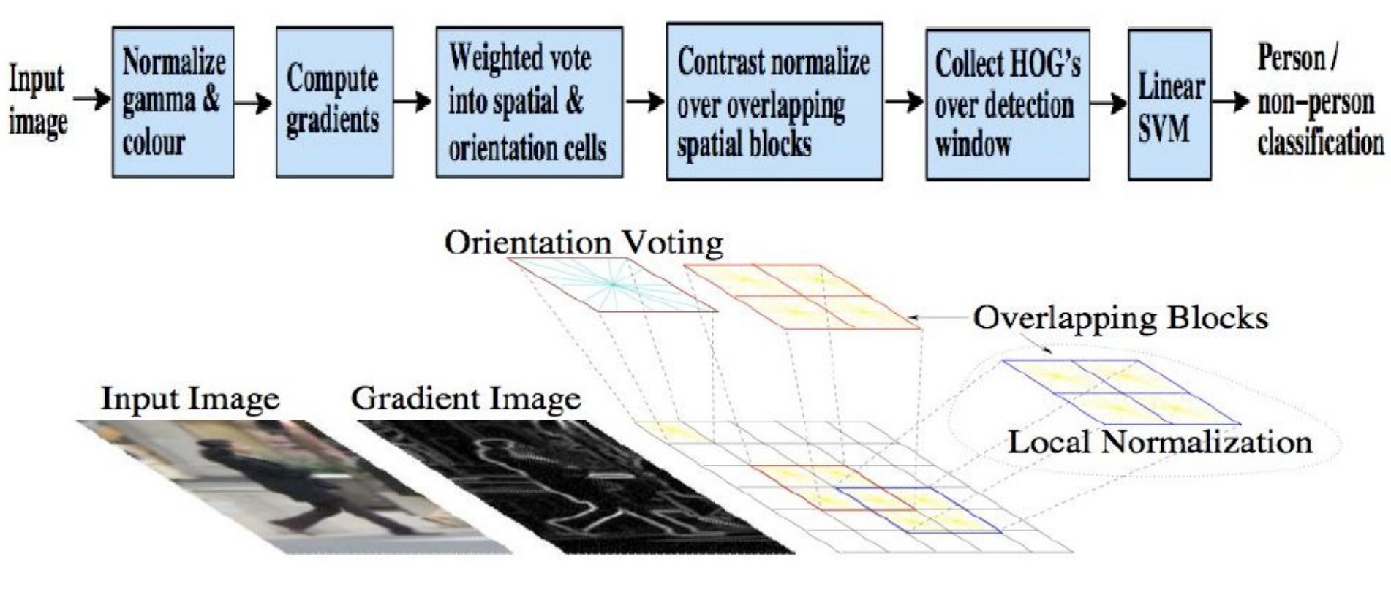
Example workflow of H.O.G from Stanford 231a

Slide 11
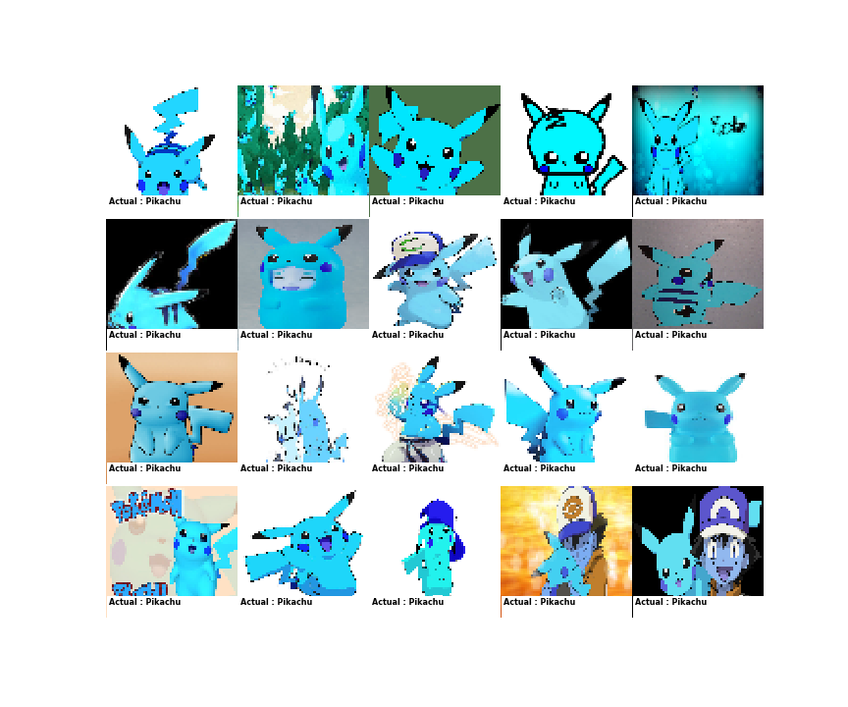
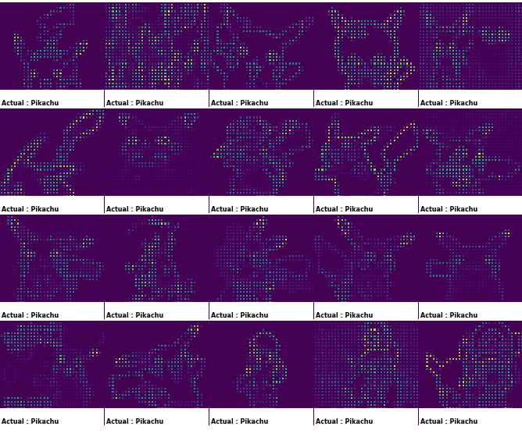
Example of H.O.G for Pokémon
Histogram of Oriented Gradients Algorithm extracts features of an image regardless of its content and ignores the background of images.
Actual Pikachu
HOG features Pikachu

Slide 12
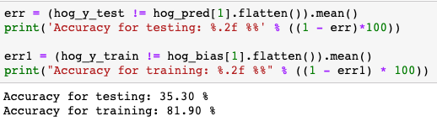
Evaluation of Model
With extracted HOG features using OpenCV library, I set up Support Vector Machine model, which divides each Pokémon space by its unique features.
By setting C value, a parameter to the trade-off in misclassification, the model is soft SVM to penalize the cost of misclassification.
Higher of C value will lower bias and increase variance.

Slide 13
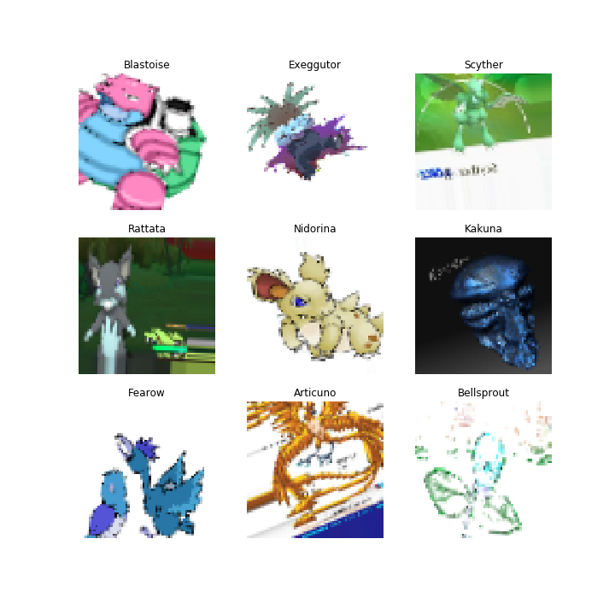
Data Augmentation for CNN
Examples of Data Augmentation
Since the dataset is not big enough, data augmentation from Keras library is applied in the training set to extend the variability of images.
Data Augmentation randomly flip or shift and change the brightness of images.
With data augmentation, CNN model can detect Pokémon within different positions.

Slide 14
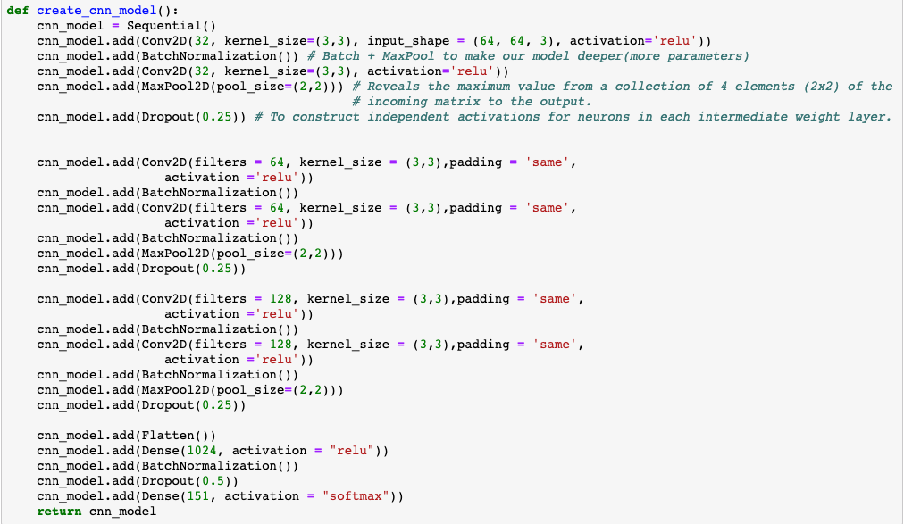
Architecture of CNN
Input Layers - 6 Convolution hidden layers with Batch Normalization, MaxPool2D and DropOut
Output Layer: Fully Connected Layer of 151 nodes with softmax activation function

Slide 15
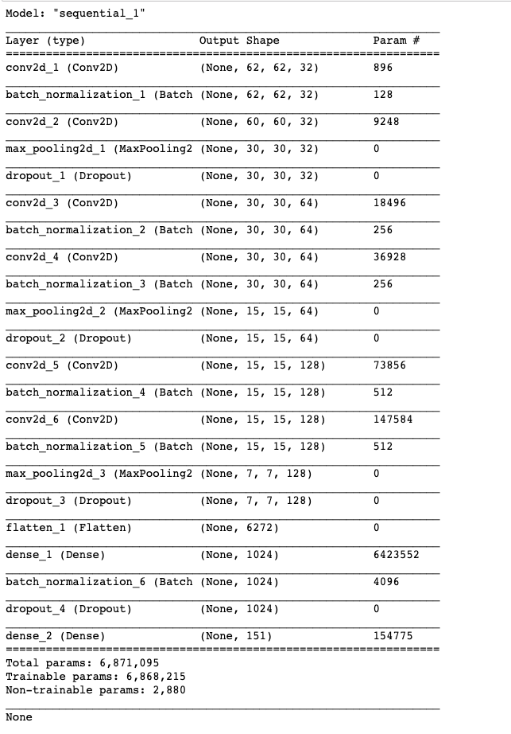
Summary of CNN Architecture

Slide 16
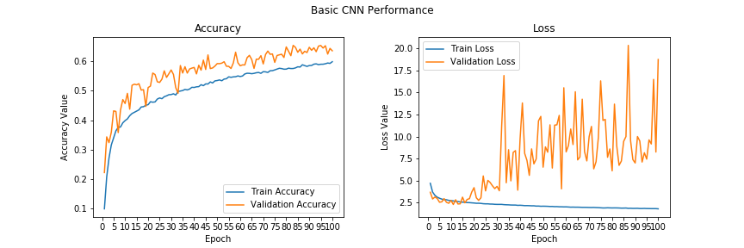
Performance of CNN
After 100 epochs of training, the model achieves the accuracy of 73% with the test data and validation loss value with the test data fluctuates.
The accuracy of CNN is way better than the accuracy of HOG+SVM, ~35.3%.

Slide 17
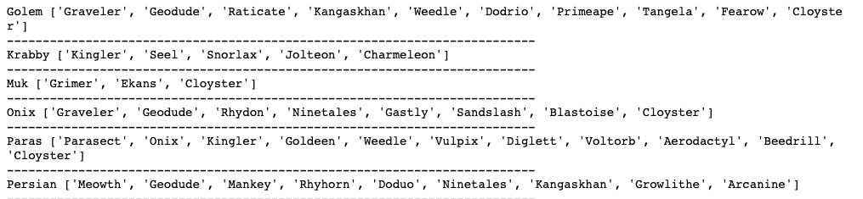
Which Pokémon are not classified well?
'Golem', 'Krabby', 'Muk', 'Onix', 'Paras', 'Persian' were not classified correctly due to the relatively small amount of image data.
Here are our False Negative Pokémon, which has no True Positive.

Slide 18
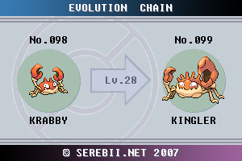
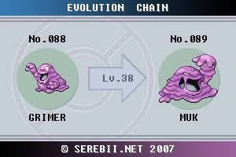
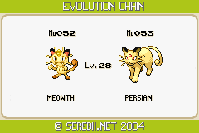
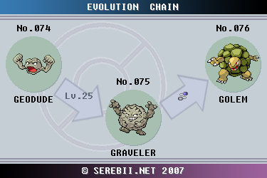
Top Misclassified Pokémon

Slide 19
Future Work
Apply Transfer Learning to use pre-trained weights from massive datasets.
Gather more images of Pokémon that was not classified well with current Pokédex to increase the accuracy of CNN.
Annotate bounding boxes for each images to train Mask RCNN/Faster RCNN to detect position of Pokémon in Pokémon clips.
Deploy Deep Learning model to IOS Application, so that everyone can use it with their smartphones.

